Slide 1


)K.R. NANGALAN UNIVERSİTY
T H E C 0 M P L E T E W O R L D 0 F E D U C AT 1 0 N
Recognised under the section 2 (f) of the UGC Act 1956
Empowering the Youth; Empowering the Nation

Slide 2


Project Title
Second Year Project Synopsis Submitted by
ROLL | NAME
2301730072 | Shashikant Bharti
2301730078 | Kunal Rai
2301730109 | Mohit Goel
2301730124 | Ronak Kumar
Industry Mentor: Mr. Akhilesh Faculty Mentor: Dr. Aarti

Slide 3


Project Overview
Stationary Inventory Management System
This presentation outlines the development of a
stationary inventory management system using Java and MySQL to streamline and optimize the inventory process.

Slide 4
About the Problem
Manual Processes
Stock Shortages and Overstocking
Limited Reporting
Traditional methods lack
comprehensive reporting
Manual tracking and Lack of real-time visibility
management of stationary into inventory levels results _{capabilities, making it}
inventory leads to
inaccuracies and inefficiencies.
in stock shortages or
overstocking.
difficult to analyze
inventory trends.

Slide 5

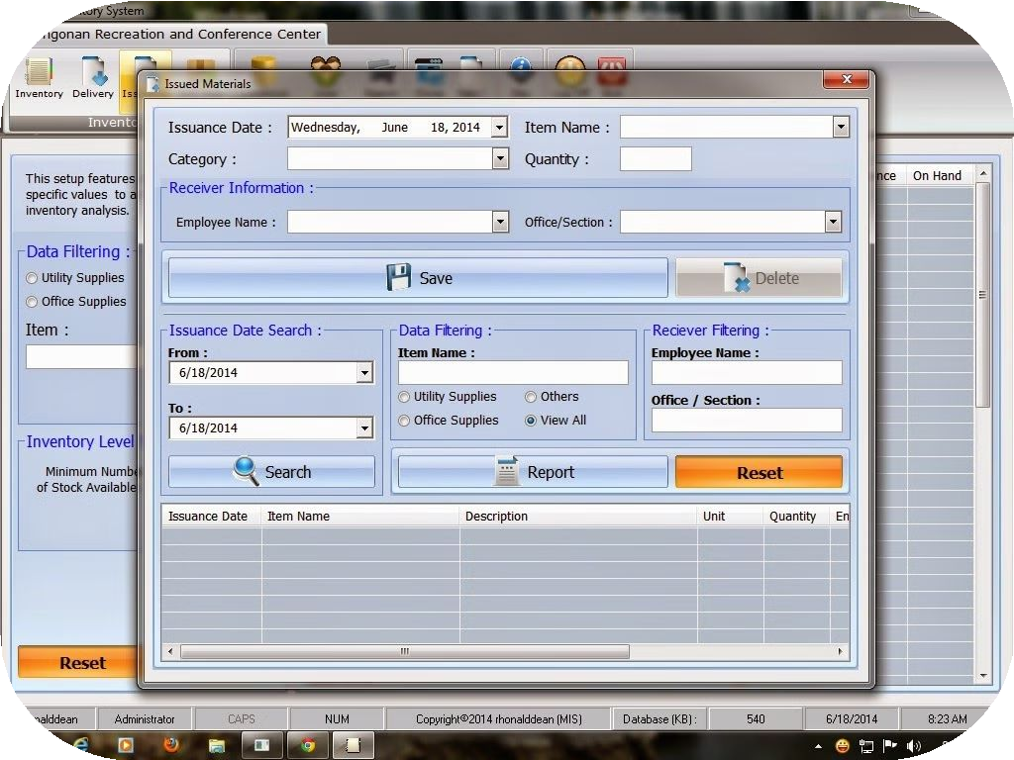
Problem Statement
The current manual stationary inventory
management system is inefficient, leading to inaccuracies, stock imbalances, and limited reporting capabilities. This project aims to address these issues by developing a robust and automated system to improve inventory management, reduce waste, and enhance overall efficiency.

Slide 6
Project Objectives
Develop a User-Friendly Interface
Create a user-friendly interface for easy data entry, retrieval, and reporting.
Generate Comprehensive Reports
Provide detailed reports on inventory levels, usage trends, and reorder points.
Implement Automated Inventory Tracking
Automate inventory tracking and management processes to ensure accurate real-time data.
Enhance Efficiency and Accuracy
Streamline inventory operations, reducing manual effort and ensuring data accuracy.

Slide 7
Methodology, Tools, and Techniques
Approach
The project uses the Agile method, meaning it is developed in small steps. Each step improves the project based on feedback, ensuring continuous progress.
Tools & Techniques
The project uses HTML for the front end, Java for the backend, and MySQL for the database.

Slide 8
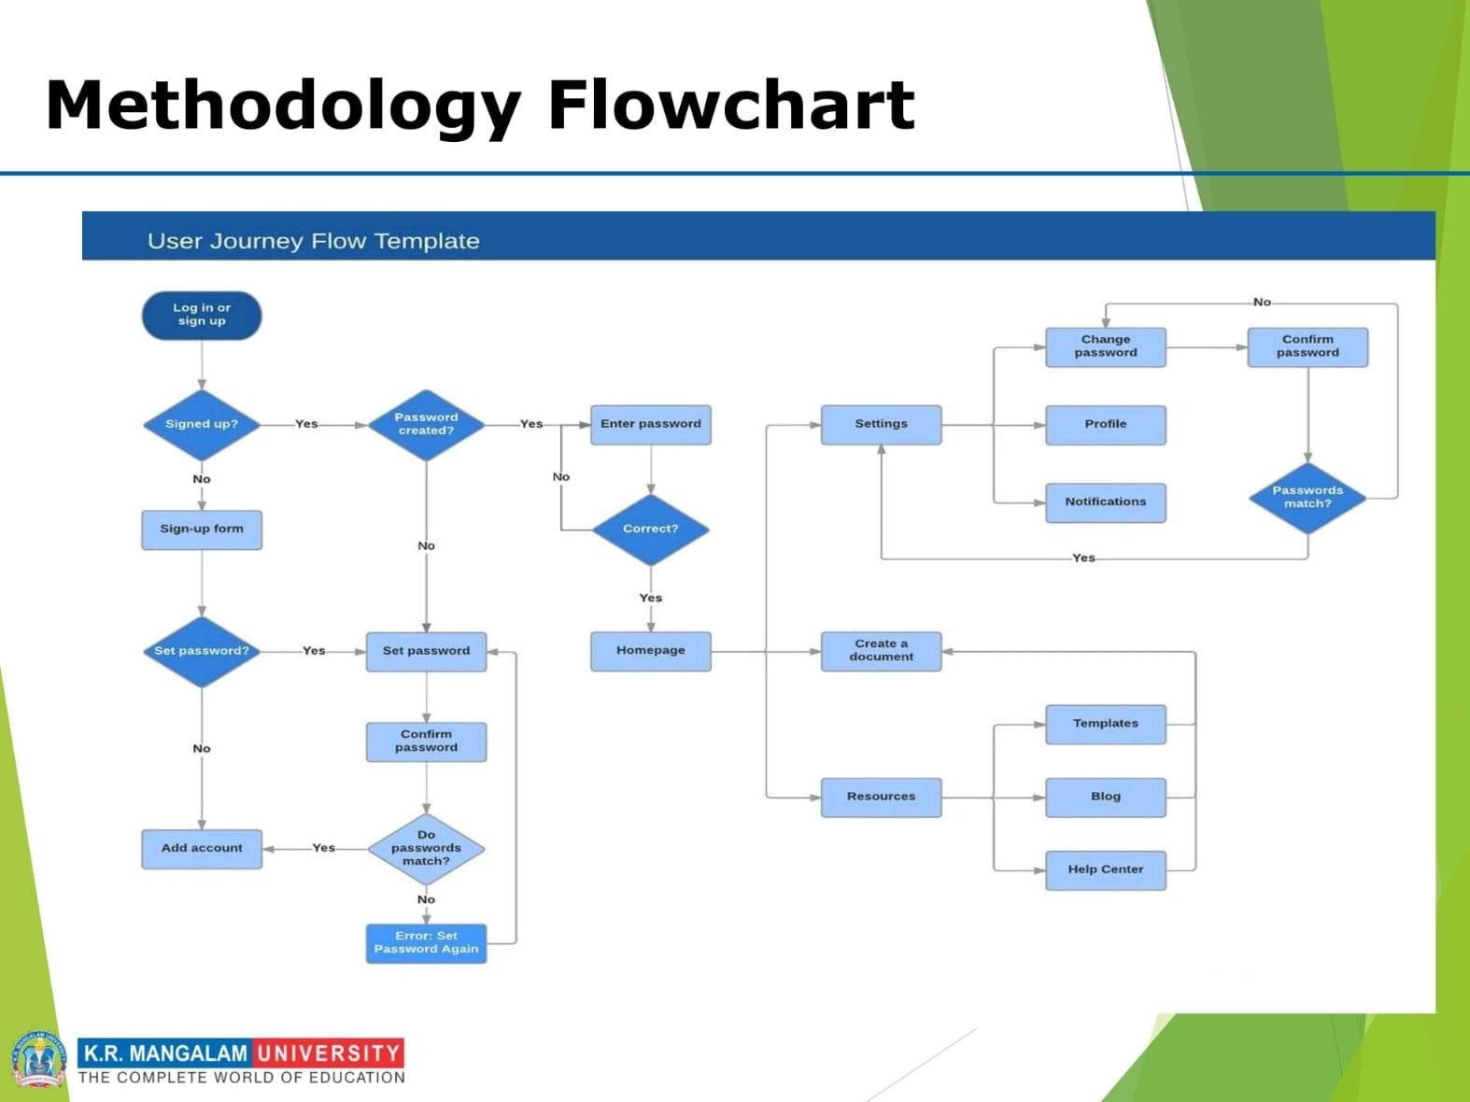

Slide 9
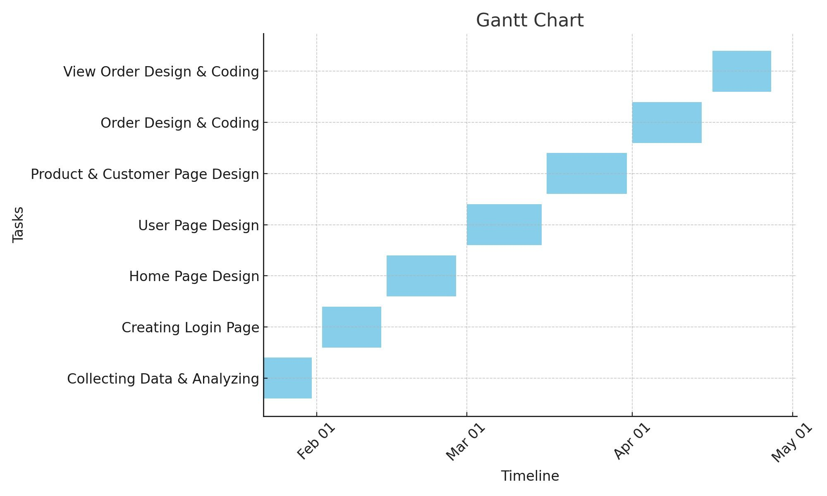

Project Timeline

Slide 10
Expected Results & Impact
Expected Results
Impact
The project is expected to deliver a
functional stationary inventory management system that provides real-time inventory tracking, automated reorder processes, and comprehensive reporting capabilities.
The system will improve operational
efficiency, reduce inventory costs, minimize stock shortages, and provide valuable insights for informed decision-making.

Slide 11

THANK YOU

